Slide 1
Project 3 – GigGuide.com
David Avellaneda
Ben Tokarczyk

Slide 2
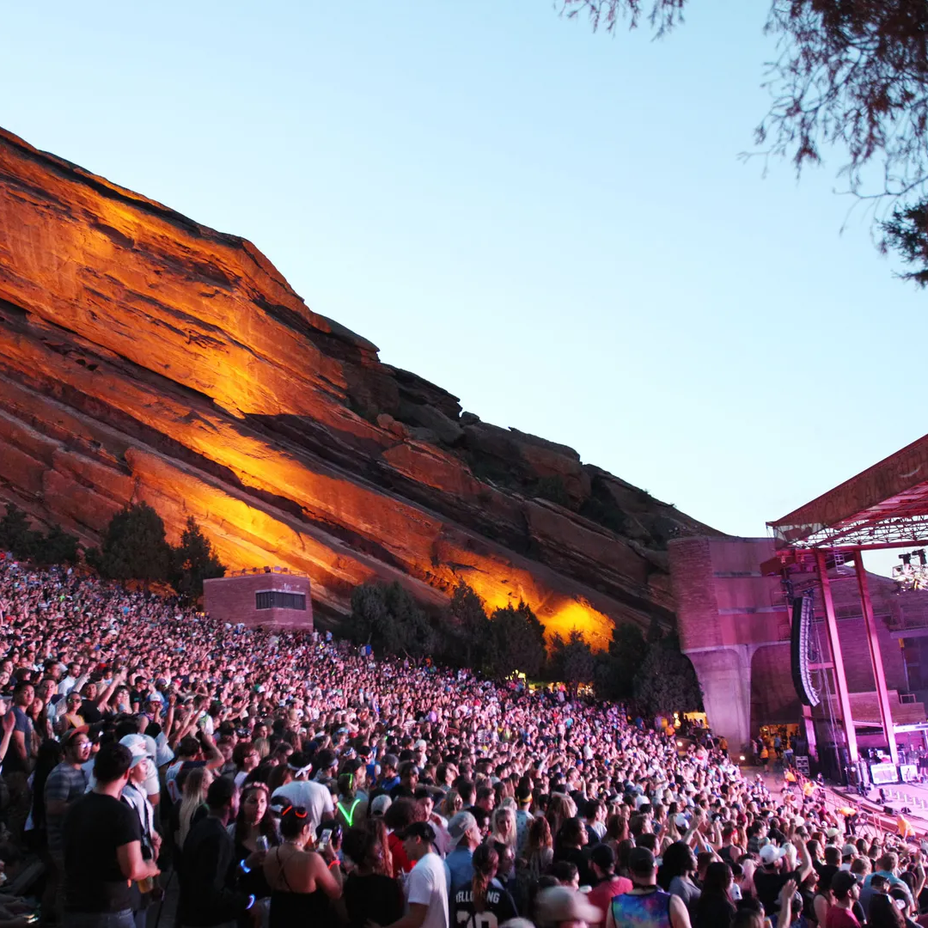
Agenda
Data Wrangling
Data Visualization
Lessons Learned

Slide 3
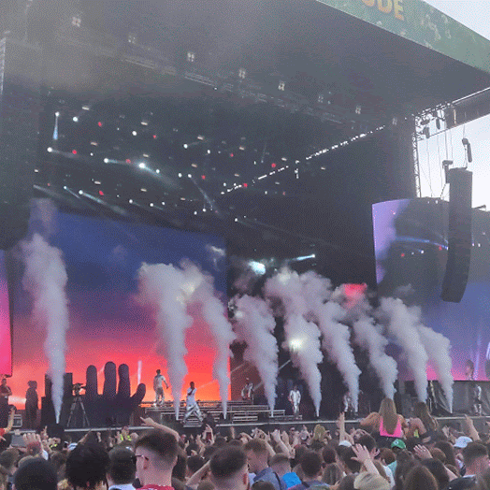
Data Wrangling
Utilizing MongoDB for Unstructured Data

Slide 4
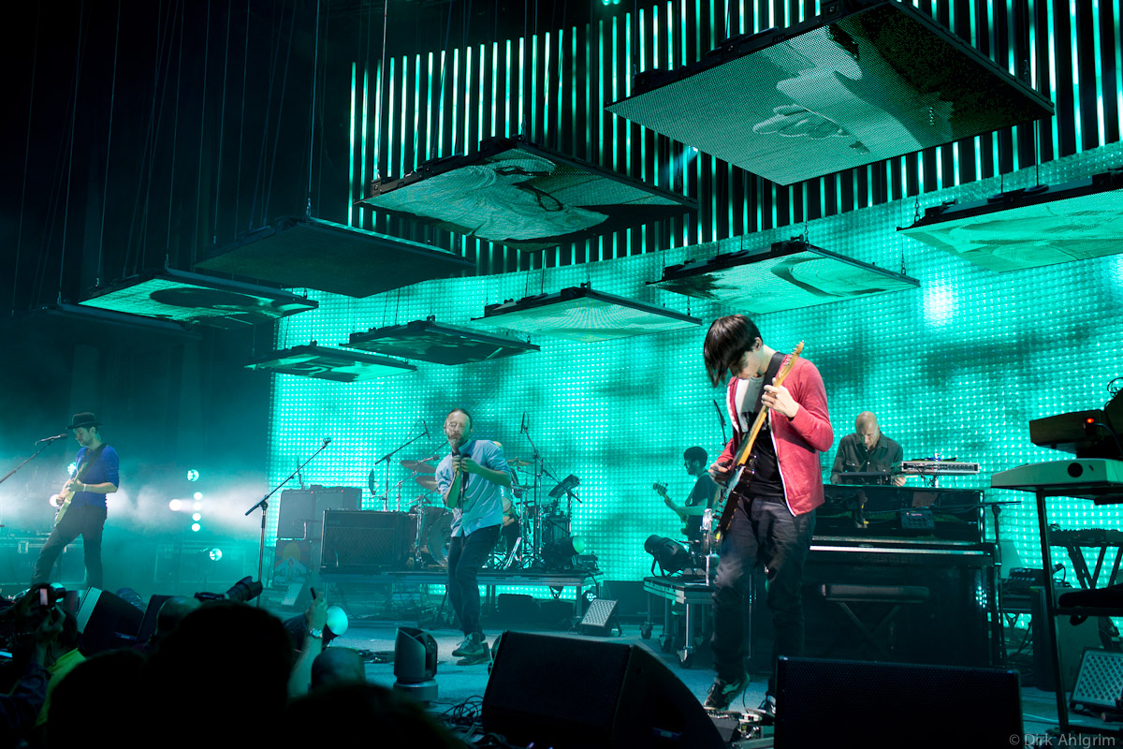
MongoDB Collections and Documents
Events
Single event on date/venue with multiple artist
Attractions
Single artist/event with date/venue information
Tour Run
Individual artist with multiple dates and venues

Slide 5
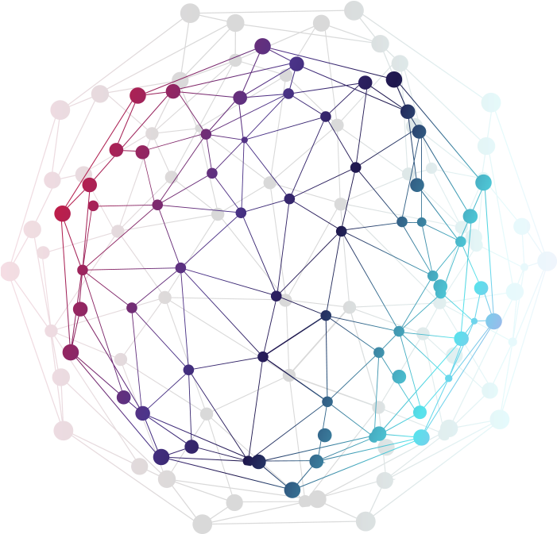
Data Visualizations
Enhancing your presentation

Slide 6

Mapping, list Generation and gifs
Using a new library, we were able to create the Bar Chart Race within Python to show how many concerts were happening based on genre through our chosen time period
Cluster mapping techniques learnt in class were utilized in our second map to showcase concerts happening in various locations across the united states
Creating dropdown and event handler to add layers to map drawing out the tour route of selected artist

Slide 7

Lessons Learned
That’s why it’s called learning…

Slide 8
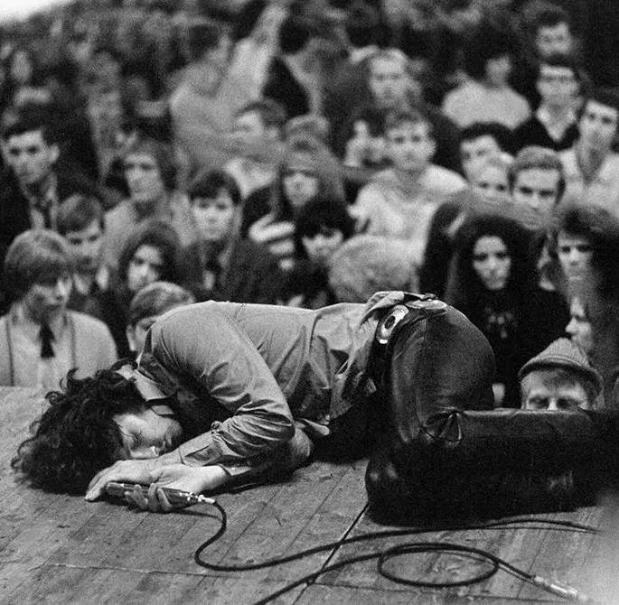
Setbacks and bad assumptions
Adding a delay timer on your API call worrying it might fail cost hours
Don’t expect data to be perfect
Trying to coordinate different parts of the project

Slide 9

Thank you
Ben Tokarczyk
David Avellaneda

